Slide 1
Campaign Name
11-07-2016

Slide 2
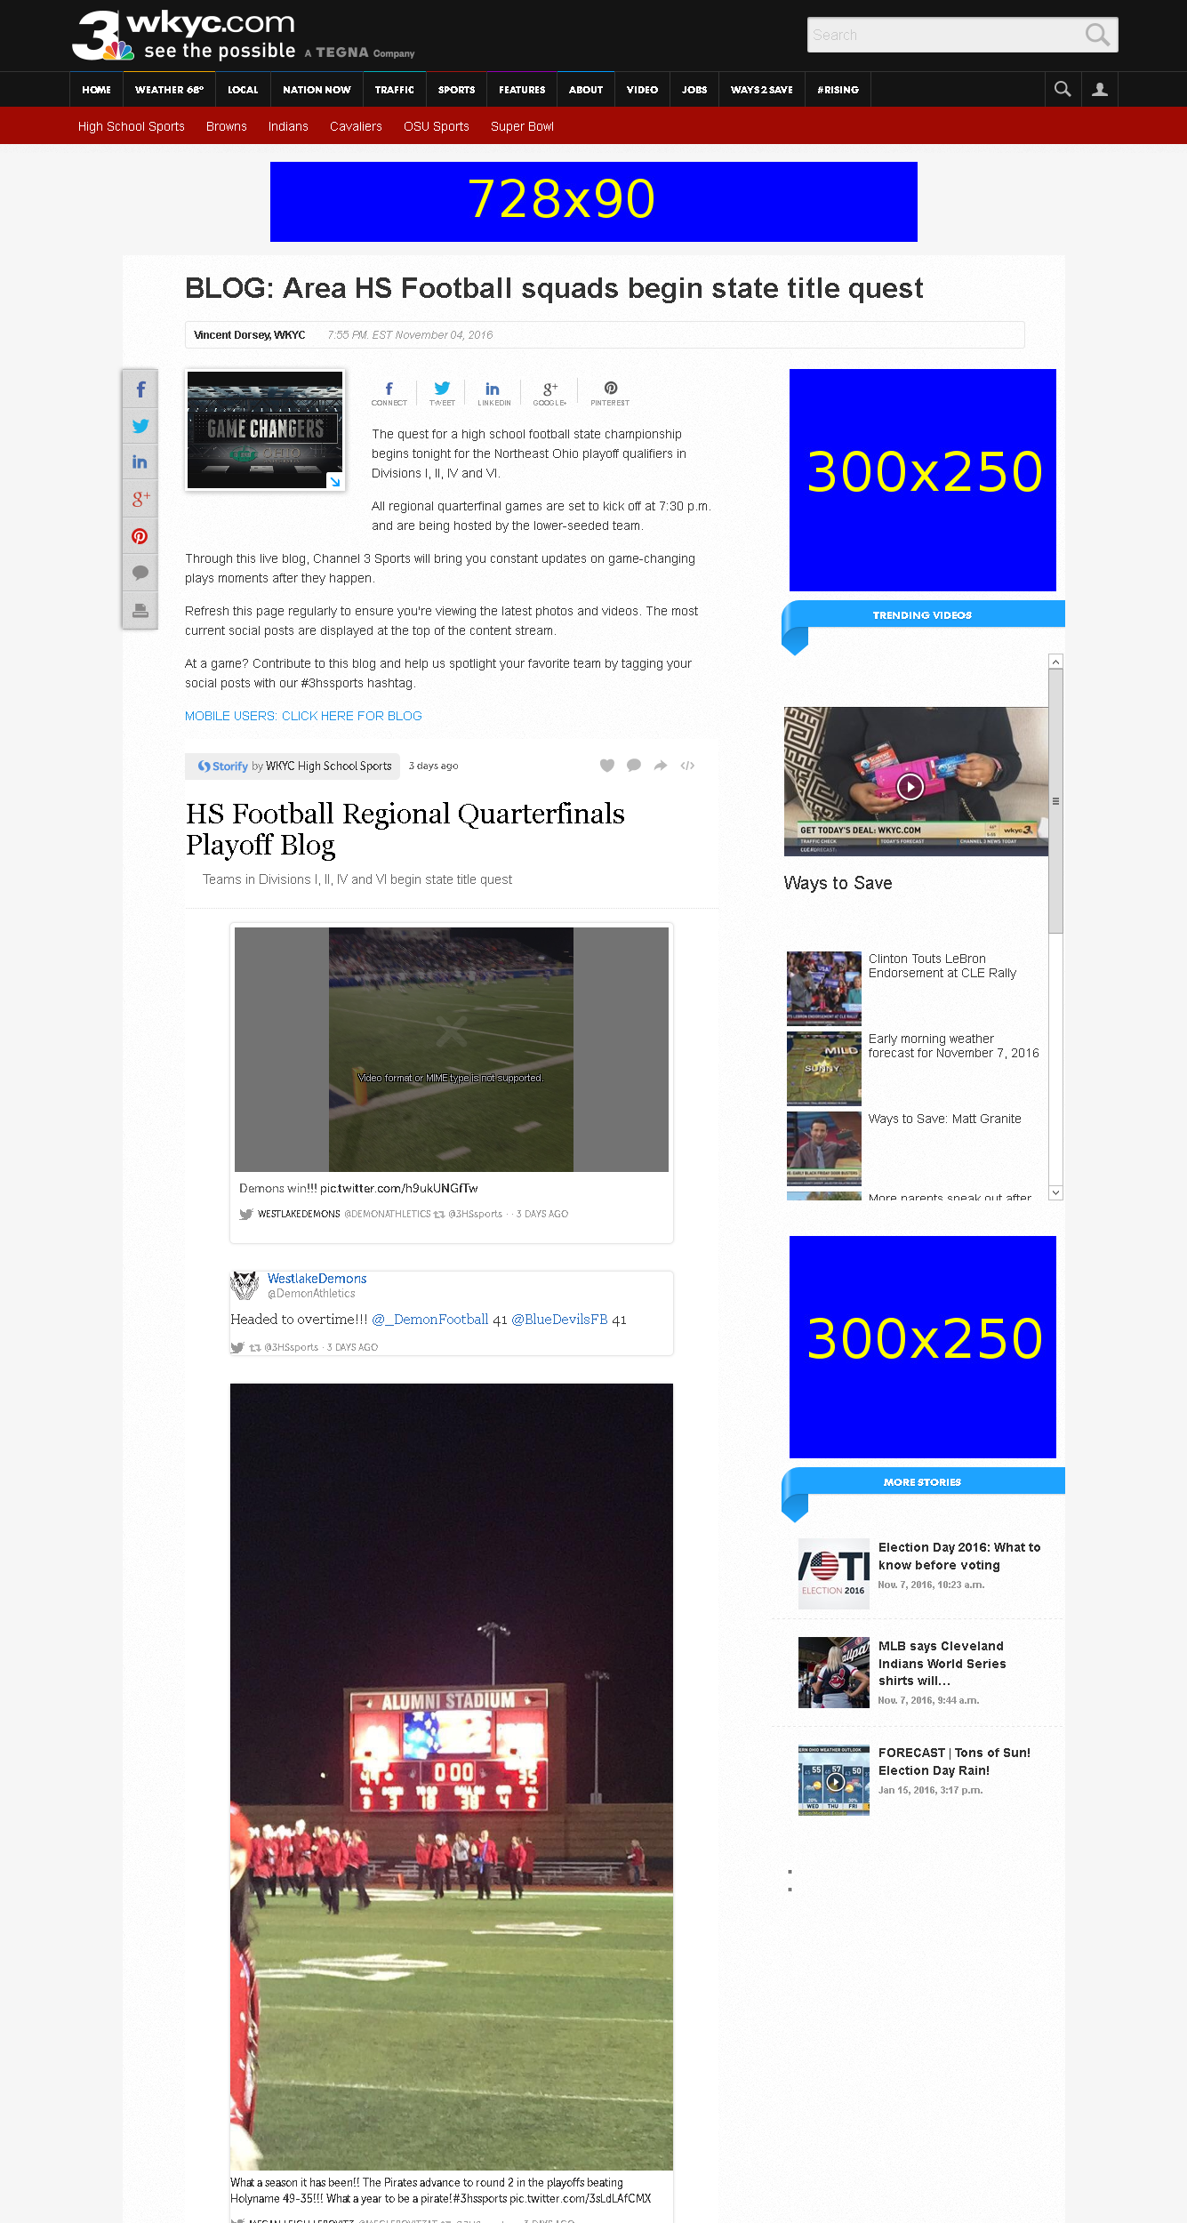
http://www.wkyc.com/sports/high-school/blog-area-hs-football-squads-begin-state-title-quest/348206721

Slide 3
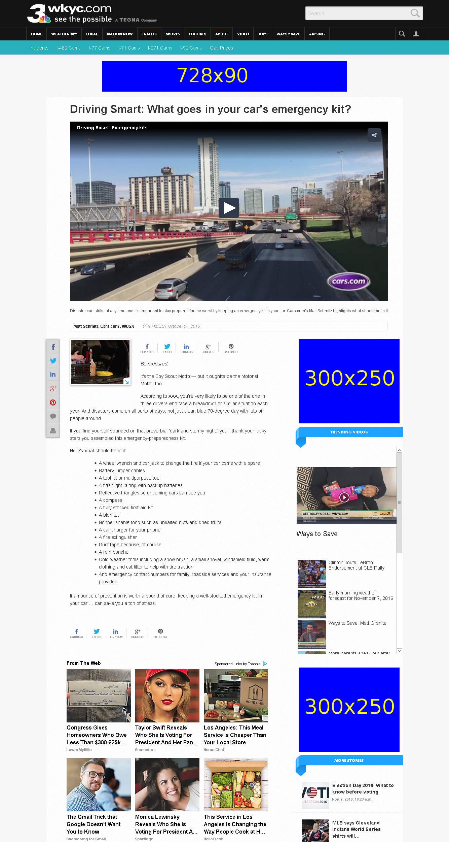
http://www.wkyc.com/traffic/driving-smart/driving-smart-what-goes-in-your-cars-emergency-kit/329880761

Slide 4
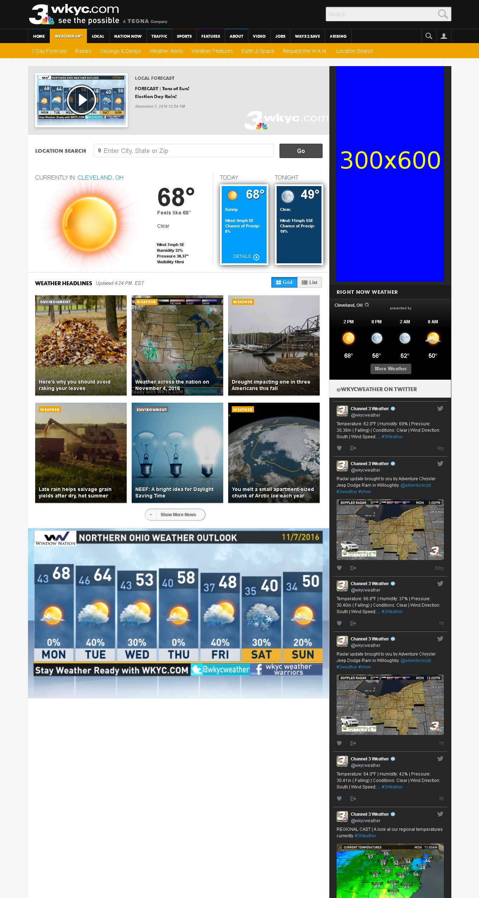
http://www.wkyc.com/weather

